Slide 1
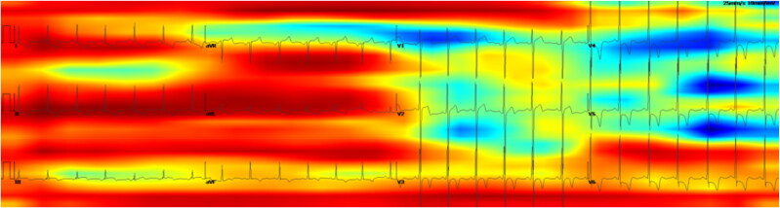
https://pmc.ncbi.nlm.nih.gov/articles/PMC10360981/

Slide 2
A Multicenter Evaluation of the Impact of Therapies on Deep Learning-Based Electrocardiographic Hypertrophic Cardiomyopathy Markers
Population:
Patients with hypertrophic cardiomyopathy (HCM) undergoing surgical or percutaneous septal reduction therapy (SRT) or receiving mavacamten therapy.
Size:
• SRT group: 315 patients (70 at Yale New Haven Health System [YNHHS], 100 at Cleveland Clinic Foundation [CCF], 145 at Atlantic Health System [AHS]).
• Mavacamten group: 36 patients at YNHHS.
Location:
Multicenter: YNHHS, CCF, and AHS for SRT; single-center (YNHHS) for mavacamten therapy.
Question:
Can artificial intelligence-enhanced electrocardiography (AI-ECG) be used to evaluate biological responses to SRT and mavacamten in patients with HCM?
Method:
AI-ECG models for HCM detection were applied to electrocardiograms from patients undergoing SRT at the three sites and to those receiving mavacamten therapy at YNHHS. Pre- and post-intervention AI-ECG HCM scores were analyzed and compared.
https://pubmed.ncbi.nlm.nih.gov/39581517/

Slide 3
True HCM vs phenocpies, a matter of therapy
Novel targeted treatments increase the need for prompt hypertrophic cardiomyopathy (HCM) detection. However, its low prevalence (0.5%) and resemblance to common diseases present challenges that may benefit from automated machine learning–based approaches. We aimed to develop machine learning models to detect HCM and to differentiate it from other cardiac conditions using ECGs and echocardiograms, with robust generalizability across multiple cohorts.

Slide 4
Detection of HCM
Disease phase often neglected?
Differentiation between types of hypertrophy

Slide 5
Multinational Federated Learning Approach to Train ECG and Echocardiogram Models for Hypertrophic Cardiomyopathy Detection
Single-institution HCM ECG models were trained and validated on external data. Multi-institution models for ECG and echocardiogram were trained on data from 3 academic medical centers in the United States and Japan using a federated learning approach, which enables training on distributed data without data sharing. Models were validated on held-out test sets for each institution and from a fourth academic medical center and were further evaluated for discrimination of HCM from aortic stenosis, hypertension, and cardiac amyloidosis. Last, automated detection was compared with manual interpretation by 3 cardiologists on a data set with a realistic HCM prevalence.
We identified 74 376 ECGs for 56 129 patients and 8392 echocardiograms for 6825 patients at the 4 academic medical centers. Although ECG models trained on data from each institution displayed excellent discrimination of HCM on internal test data (C statistics, 0.88–0.93), the generalizability was limited, most notably for a model trained in Japan and tested in the United States (C statistic, 0.79–0.82). When trained in a federated manner, discrimination of HCM was excellent across all institutions (C statistics, 0.90–0.96 and 0.90–0.96 for ECG and echocardiogram model, respectively), including for phenotypic subgroups. The models further discriminated HCM from hypertension, aortic stenosis, and cardiac amyloidosis (C statistics, 0.84, 0.83, and 0.88, respectively, for ECG and 0.93, 0.94, 0.85, respectively, for echocardiogram). Analysis of electrocardiography-echocardiography paired data from 11 823 patients from an external institution indicated a higher sensitivity of automated HCM detection at a given positive predictive value compared with cardiologists (0.98 versus 0.81 at a positive predictive value of 0.01 for ECG and 0.78 versus 0.59 at a positive predictive value of 0.24 for echocardiogram).
https://pmc.ncbi.nlm.nih.gov/articles/PMC9439630/

Slide 6
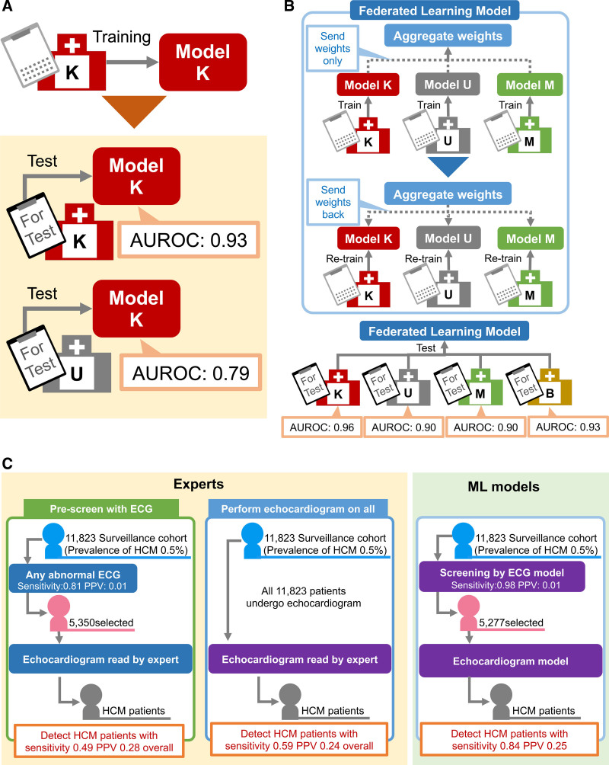

Slide 7
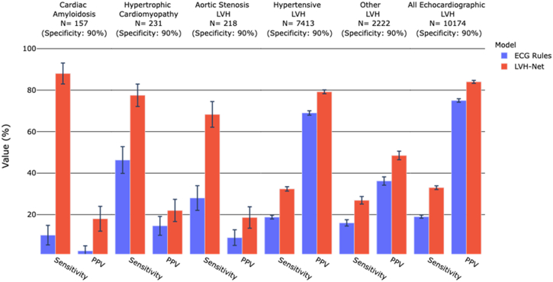
Artificial intelligence-enabled classification of hypertrophic heart diseases using electrocardiograms
https://pubmed.ncbi.nlm.nih.gov/37101945/

Slide 8
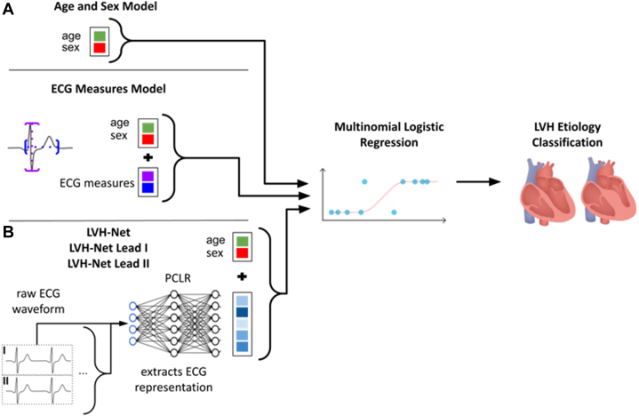

Slide 9
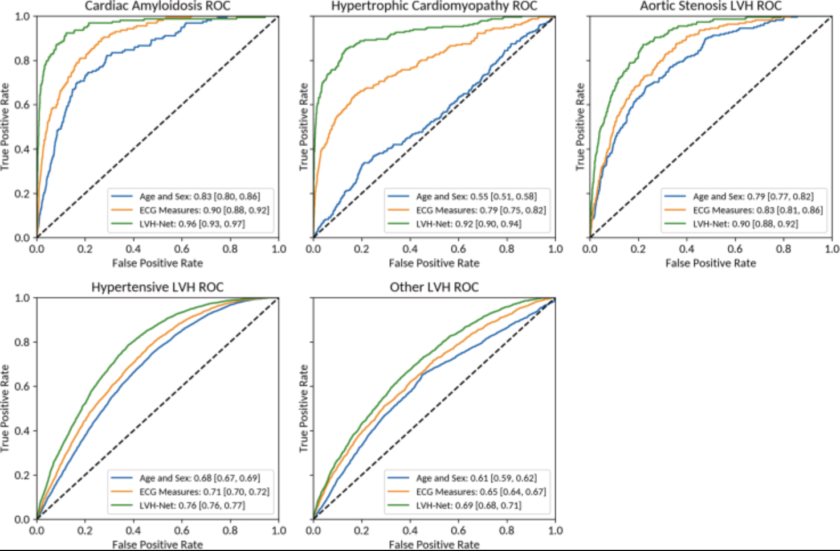

Slide 10
Detection of Hypertrophic Cardiomyopathy Using a Convolutional Neural Network-Enabled Electrocardiogram
Methods
A convolutional neural network (CNN) was trained and validated using digital 12-lead ECG from 2,448 patients with a verified HCM diagnosis and 51,153 non-HCM age- and sex-matched control subjects. The ability of the CNN to detect HCM was then tested on a different dataset of 612 HCM and 12,788 control subjects.
Results
In the combined datasets, mean age was 54.8 ± 15.9 years for the HCM group and 57.5 ± 15.5 years for the control group. After training and validation, the area under the curve (AUC) of the CNN in the validation dataset was 0.95 (95% confidence interval [CI]: 0.94 to 0.97) at the optimal probability threshold of 11% for having HCM. When applying this probability threshold to the testing dataset, the CNN’s AUC was 0.96 (95% CI: 0.95 to 0.96) with sensitivity 87% and specificity 90%. In subgroup analyses, the AUC was 0.95 (95% CI: 0.94 to 0.97) among patients with left ventricular hypertrophy by ECG criteria and 0.95 (95% CI: 0.90 to 1.00) among patients with a normal ECG. The model performed particularly well in younger patients (sensitivity 95%, specificity 92%). In patients with HCM with and without sarcomeric mutations, the model-derived median probabilities for having HCM were 97% and 96%,
https://www.sciencedirect.com/science/article/pii/S0735109720300036?via%3Dihub
Notes:
A convolutional neural network (CNN) was trained and validated using digital 12-lead ECG from 2,448 patients with a verified HCM diagnosis and 51,153 non-HCM age- and sex-matched control subjects. The ability of the CNN to detect HCM was then tested on a different dataset of 612 HCM and 12,788 control subjects.

Slide 11
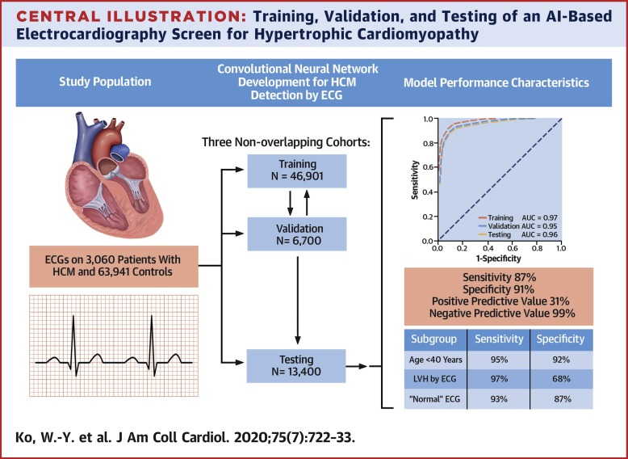

Slide 12
Postdevelopment Performance and Validation of the Artificial Intelligence-Enhanced Electrocardiogram for Detection of Cardiac Amyloidosis
Population:
Patients with cardiac amyloidosis (CA) diagnosed after the development of an AI-enhanced ECG algorithm. The average age was 70.4 ± 10.3 years, 25% were female, and most were White (91.3%).
Country:
United States
Size:
• Amyloid patients: 440.
• Control group: 6,600 age- and sex-matched individuals.
Location:
Single-country, multicenter study.
Question:
What is the performance of an AI-enhanced ECG in detecting cardiac amyloidosis (CA) across different patient subgroups, including potential confounding factors?
Method:
An AI-enhanced ECG algorithm was validated by analyzing ECG data from patients diagnosed with CA between June 2019 and January 2022. Area under the receiver operating characteristic (AUC) values were calculated for the overall cohort and specific subgroups based on demographics, amyloid subtypes, and ECG patterns.
Result:
• Overall AUC: 0.84 (95% CI: 0.82-0.86), slightly lower than the original study (AUC 0.91).
• Subgroup performance: High AUC (>0.81) for White, Black, and “other” racial groups; lower performance for Hispanic patients (AUC 0.66).
• ECG features: High performance for low voltage and infarct patterns (AUC >0.90); reduced performance for left ventricular hypertrophy and left bundle branch block (AUC 0.75 and 0.76, respectively).
• The algorithm maintained stable performance over time but showed the need for further validation in specific subgroups, particularly ethnically diverse populations and those with specific ECG abnormalities.
https://pubmed.ncbi.nlm.nih.gov/38638999/
Notes:
All patients included in this study were seen and evaluated at the Mayo Clinic. While this is an internal validation effort, as the original AI-ECG algorithm was developed from the same patient demographic/population, none of the patients in these analyses participated in the derivation of algorithm, and all ECGs in the analysis were acquired after the model was fully developed.

Slide 13
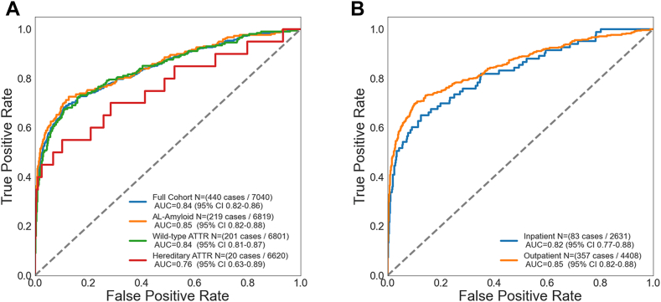
Notes:
Algorithm Performance With Respect to Amyloidosis Subtype and ECG Recording Location
(A) AI-ECG for amyloidosis performance with respect to amyloid subtype and (B) ECG recording location. Graphic demonstration of the receiver operating characteristic for the AI-ECG algorithm to identify amyloidosis among the (A) various amyloid subtypes: AL (N = 219), wild-type ATTR (N = 201), and hereditary ATTR (n = 20) cardiac amyloidosis. The graph on the right (B) demonstrates AI-ECG algorithm performance using inpatient or outpatient ECGs. One ECG in the location subgroup was unable to have a verified location of recording. AI = artificial intelligence; AL = light chain amyloidosis; ATTR = transthyretin amyloidosis; ECG = electrocardiogram.

Slide 14
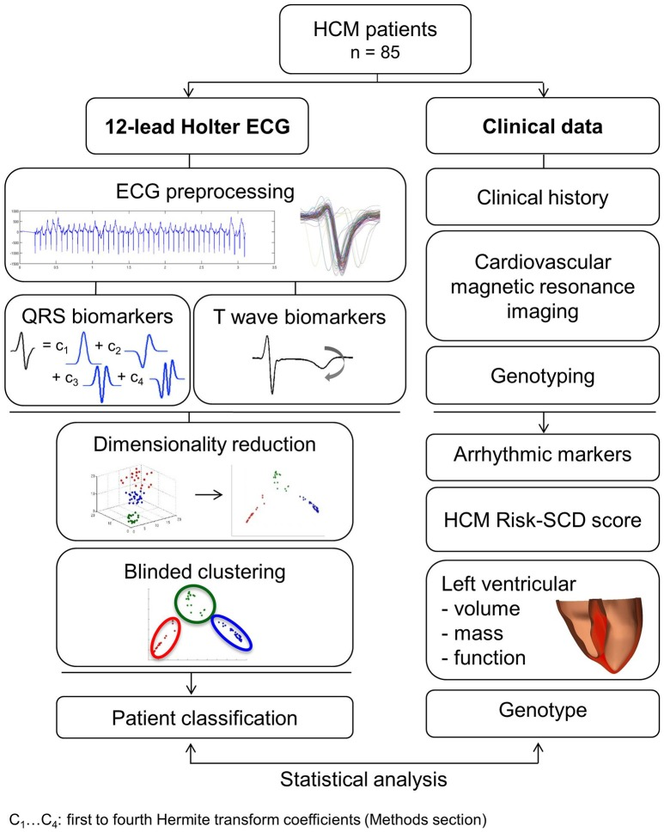
Distinct ECG Phenotypes Identified in Hypertrophic Cardiomyopathy Using Machine Learning Associate With Arrhythmic Risk Markers
Population:
Patients with hypertrophic cardiomyopathy (HCM) and healthy volunteers. HCM patients were evaluated for phenotypic and clinical risk differences, with a focus on sudden cardiac death (SCD) risk.
Country:
Not specified in the abstract.
Size:
• HCM patients: 85
• Healthy volunteers: 38
Location:
Not specified, likely single-center or multicenter.
Question:
Can distinct HCM phenotypes be identified using computational ECG analysis, and how do these phenotypes correlate with clinical risk factors, SCD risk, and anatomical differences observed via cardiac magnetic resonance (CMR) imaging?
Method:
• Data collection: High-fidelity 12-lead Holter ECGs were analyzed using mathematical modeling and computational clustering.
• Grouping: ECG phenotypes were classified based on QRS morphology and T wave biomarkers.
• Clinical correlation: Clinical features, SCD risk (HCM Risk-SCD scores), and hypertrophy patterns assessed by CMR imaging were evaluated across phenotypic subgroups.
Result:
• Phenotypic classification:
• Based on QRS morphology: Three groups were identified:
• Group 1 (n = 44): Normal QRS morphology.
• Group 2 (n = 19): Short R and deep S waves in V4.
• Group 3 (n = 22): Short R and long S waves in V4-6 with left QRS axis deviation.
• No significant differences in arrhythmic risk or hypertrophy distribution were observed between these groups.
• Including T wave biomarkers: Four groups were identified:
• Group 1A (n = 20): Normal QRS with primary T wave inversion.
• Group 1B (n = 24): Normal QRS with upright T waves.
• Group 2 and Group 3: Retained QRS patterns, with upright T waves.
• Risk and hypertrophy patterns:
• Group 1A had significantly higher HCM Risk-SCD scores (4.0%) compared to other groups (1B: 1.8%, Group 2: 2.1%, Group 3: 2.5%, p = 0.0001).
• Group 1A exhibited coexisting septal and apical hypertrophy, while Groups 2 and 3 predominantly showed septal hypertrophy.
Conclusion:
HCM patients were classified into four subgroups with distinct ECG features. Patients with primary T wave inversion (Group 1A) had increased SCD risk and coexisting septal and apical hypertrophy, suggesting that primary T wave inversion may independently predict higher SCD risk. Computational ECG phenotyping offers valuable insights into HCM and has potential as a novel, independent factor for SCD risk stratification.

Slide 15
Assessment of Disease Status and Treatment Response With Artificial Intelligence-Enhanced Electrocardiography in Obstructive Hypertrophic Cardiomyopathy
We applied two AI-ECG algorithms to pre-treatment and on-treatment ECGs from the phase 2 PIONEER-OLE trial(3) of the cardiac myosin inhibitor mavacamten in patients with obstructive HCM. The two AI-ECG algorithms were independently developed and trained at the University of California San Francisco (UCSF; San Francisco, CA, US)(1) and Mayo Clinic (Rochester, MN, US)(2) as previously described; institutional review board approval was obtained from both institutions. PIONER-OLE patients had 12-lead ECGs, echocardiography, and drug plasma and N-terminal pro B-type natriuretic peptide (NT-proBNP) measurements at day 0 (pre-treatment), weeks 4, 8, and 12, and every 12 weeks thereafter. Both algorithms were first validated in cohorts constructed by combining pre-treatment ECGs from PIONEER-OLE patients (n=13) and age- and sex-matched control ECGs from subjects without HCM from Mayo Clinic and UCSF (n=2,600 each) in a 1:200 ratio to approximate HCM prevalence. Both algorithms were then applied to all ECGs (n=216) from each PIONEER-OLE patient acquired pre-treatment and on-treatment through January 29, 2020. We examined longitudinal associations of AI-ECG-predicted HCM scores with echocardiographic and laboratory metrics important to HCM clinical decision making.
Mean age of the PIONEER-OLE cohort at baseline was 57.8 years; 69.2% of patients were male and 92.3% had New York Heart Association class II symptoms. Median follow-up was 79 weeks (range 25.0–90.1). To discriminate PIONEER-OLE pre-treatment HCM ECGs from ECGs of age/sex-matched non-HCM controls, area under the receiver operating characteristic curve (AUC) was 0.938 (95% CI, 0.924–0.950) for the UCSF algorithm and 0.979 (95% CI, 0.942–1.000) for the Mayo algorithm. Sensitivity and specificity were 84.6% and 96.3% for the UCSF algorithm, and 92.3% and 94.1% for the Mayo algorithm, respectively. When applied to all PIONEER-OLE ECGs (n=216), both algorithms demonstrated decreases in mean HCM scores during mavacamten treatment averaged across each time point, with a mean score reduction of 43% (0.67 pre-treatment to 0.38 at 72 weeks) for UCSF and a reduction of 56% (0.85 pre-treatment to 0.37 at 72 weeks) for the Mayo algorithm. The longitudinal AI-ECG HCM score trends generally mirrored the decreasing trends over time in LVOT gradient with Valsalva and NT-proBNP (Figure 1). Mavacamten pharmacokinetic levels increased on initiation then remained stably elevated over time in most patients.
https://pubmed.ncbi.nlm.nih.gov/35272798/

Slide 16
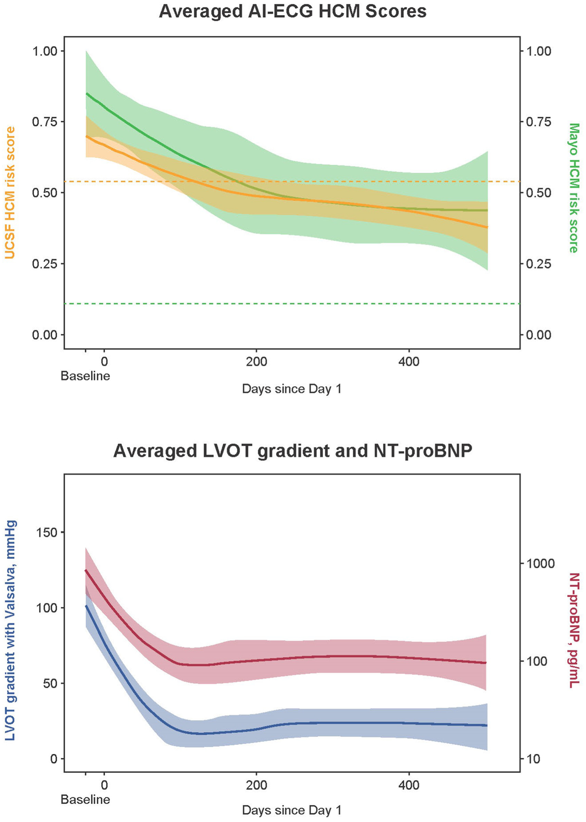

Slide 17
Identification of patients with dilated phase of hypertrophic cardiomyopathy using a convolutional neural network applied to multiple, dual, and single lead electrocardiograms
Methods
This is a retrospective analysis using a single-center prospective cohort study (Shinken Database 2010–2017, n = 19,170). After excluding those without a normal P wave on index ECG (n = 1,831) and adding dHCM patients registered before 2009 (n = 39), 17,378 digital ECGs were used. Totally 54 dHCM patients were identified of which 11 diagnosed at baseline, 4 developed during the time course, and 39 registered before 2009. The performance of the convolutional neural network (CNN) model for detecting dHCM was evaluated using eight-lead (I, II, and V1-6), single-lead, and double-lead (I, II) ECGs with the five-fold cross validation method.
Results
The area under the curve (AUC) of the CNN model to detect dHCM (n = 54) with eight-lead ECG was 0.929 (standard deviation [SD]: 0.025) and the odds ratio was 38.64 (SD 9.10). Among the single-lead and double-lead ECGs, the AUC was highest with the single lead of V5 (0.953 [SD: 0.038]), with an odds ratio of 58.89 (SD:68.56
https://www.sciencedirect.com/science/article/pii/S2352906723000428?via%3Dihub

Slide 18
Deep learning-derived 12-lead electrocardiogram-based genotype prediction for hypertrophic cardiomyopathy: a pilot study
Methods: A convolutional neural network (CNN) was built with the 12-lead electrocardiogram (ECG) of 124 HCMs who underwent genetic testing (GT), externally tested by predicting the genotype on another HCMs cohort (n = 54), and compared with the conventional methods (the Mayo and Toronto score). Using a third cohort of HCMs (n = 76), the role of the network in risk stratification was explored by calculating the sudden cardiac death (SCD) risk scorers (HCM risk-SCD) across the predicted genotypes. Score-CAM was employed to provide a visual explanation of the network.
Results: Overall, 80 of 178 HCMs (45%) were genotype-positive. Using the 12-lead ECG as input, the network showed an area under the curve (AUC) of 0.89 (95% CI, 0.83–0.96) on the test set, outperforming the Mayo score (0.69 [95% CI, 0.65–0.78], p < 0.001) and the Toronto score (0.69 [95% CI, 0.64–0.75], p < 0.001). The network classified the third cohort into two groups (predicted genotype-negative vs. predicted genotype-positive). Compared with the former, patients predicted genotype-positive had a significantly higher HCM risk-SCD (0.04 ± 0.03 vs. 0.03 ± 0.02, p <0.01). Visualization indicated that the prediction was heavily influenced by the limb lead.
Conclusions: The network demonstrated a promising ability in genotype prediction and risk assessment in HCM.
https://pubmed.ncbi.nlm.nih.gov/37467172/

Slide 19
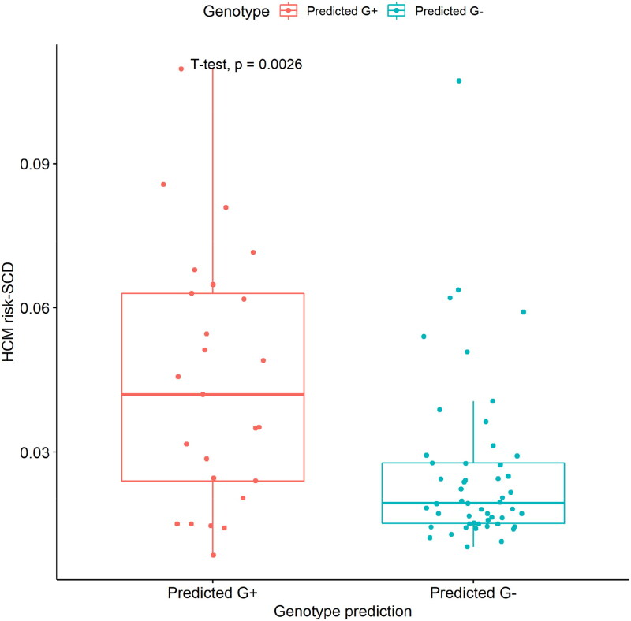

Slide 20
Saliency maps provide insights into artificial intelligence-based electrocardiography models for detecting hypertrophic cardiomyopathy
A 12‑lead electrocardiography (ECG)-based convolutional neural network (CNN) model can detect hypertrophic cardiomyopathy (HCM). However, since these models do not rely on discrete measurements as inputs, it is not apparent what drives their performance. We hypothesized that saliency maps could be used to visually identify ECG segments that contribute to a CNN's robust classification of HCM.
Methods
We derived a new one‑lead (lead I) CNN model based on median beats using the same methodology and cohort used for the original 12‑lead CNN model (3047 patients with HCM, and 63,926 sex- and age-matched non-HCM controls). One‑lead, median-beat saliency maps were generated and visually evaluated in an independent cohort of 100 patients with a diagnosis of HCM and a high artificial intelligence (AI)-ECG-HCM probability score to determine which ECG segments contributed to the model's detection of HCM.
Results
The one‑lead, median-beat CNN had an AUC of 0.90 (95% CI 0.89–0.92) for HCM detection, similar to the original 12‑lead ECG model. In the independent HCM cohort (n = 100), saliency maps highlighted the ST-T segment in 92 ECGs, the atrial depolarization segment in 12 ECGs, and the QRS complex in 5 ECGs.
Conclusions
Saliency maps of a one‑lead, median-beat-based CNN model identified perturbations in ventricular repolarization as the main region of interest in detecting HCM.
https://pubmed.ncbi.nlm.nih.gov/37599145/

Slide 21
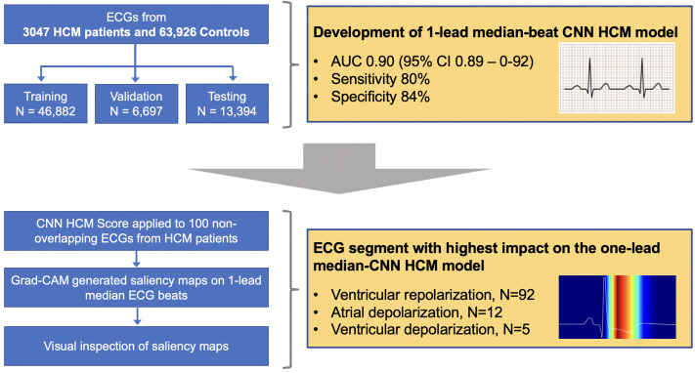

Slide 22
Patient-Level Artificial Intelligence-Enhanced Electrocardiography in Hypertrophic Cardiomyopathy: Longitudinal Treatment and Clinical Biomarker Correlations
Objectives: The purpose of this study was to determine if AI-enhanced ECG (AI-ECG) can track longitudinal therapeutic response and changes in cardiac structure, function, or hemodynamics in obstructive HCM during mavacamten treatment.
Methods: We applied 2 independently developed AI-ECG algorithms (University of California-San Francisco and Mayo Clinic) to serial ECGs (n = 216) from the phase 2 PIONEER-OLE trial of mavacamten for symptomatic obstructive HCM (n = 13 patients, mean age 57.8 years, 69.2% male). Control ECGs from 2,600 age- and sex-matched individuals without HCM were obtained. AI-ECG output was correlated longitudinally to echocardiographic and laboratory metrics of mavacamten treatment response.
Results: In the validation cohorts, both algorithms exhibited similar performance for HCM diagnosis, and exhibited mean HCM score decreases during mavacamten treatment: patient-level score reduction ranged from approximately 0.80 to 0.45 for Mayo and 0.70 to 0.35 for USCF algorithms; 11 of 13 patients demonstrated absolute score reduction from start to end of follow-up for both algorithms. HCM scores were significantly associated with other HCM-relevant parameters, including left ventricular outflow tract gradient at rest, postexercise, and with Valsalva, and NT-proBNP level, independent of age and sex (all P < 0.01). For both algorithms, the strongest longitudinal correlation was between AI-ECG HCM score and left ventricular outflow tract gradient postexercise (slope estimate: University of California-San Francisco 0.70 [95% CI: 0.45-0.96], P < 0.0001; Mayo 0.40 [95% CI: 0.11-0.68], P = 0.007).
Conclusions: AI-ECG analysis longitudinally correlated with changes in echocardiographic and laboratory markers during mavacamten treatment in obstructive HCM. These results provide early evidence for a potential paradigm for monitoring HCM therapeutic response.
https://pubmed.ncbi.nlm.nih.gov/38076758/

Slide 23
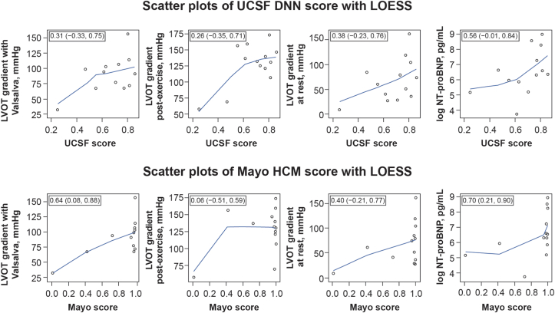
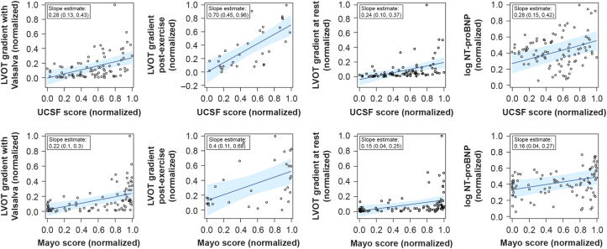

Slide 24
Identification of Hypertrophic Cardiomyopathy on Electrocardiographic Images with Deep Learning
Background: Hypertrophic cardiomyopathy (HCM) affects 1 in every 200 individuals and is the leading cause of sudden cardiac death in young adults. HCM can be identified using an electrocardiogram (ECG) raw voltage data and deep learning approaches, but their point-of-care application is limited by the inaccessibility of these signal data. We developed a deep learning-based approach that overcomes this limitation and detects HCM from images of 12-lead ECGs across layouts.
Methods: We identified ECGs from patients with HCM features present on cardiac magnetic resonance imaging (CMR) or those within 30 days of an echocardiogram documenting thickened interventricular septum (end-diastolic interventricular septum thickness > 15mm). Patients with CMR-confirmed HCM were considered as cases during the final model evaluation. The model was validated within clinical settings at YNHH and externally on ECG images from the prospective, population-based UK Biobank cohort. We localized class-discriminating signals in ECG images using gradient-weighted class activation mapping.
Results: Overall, 124,553 ECGs from 66,987 individuals (HCM cases and controls) were used for model development. The model demonstrated high discrimination for HCM across various ECG image formats and calibrations in internal validation (area under receiving operation characteristics [AUROC] 0.96) and external sets of ECG images from UK Biobank (AUROC 0.94). A positive screen for HCM was associated with a 100-fold higher odds of CMR-confirmed HCM (OR 102.4, 95% Confidence Interval, 57.4 - 182.6) in the held-out set. Class-discriminative patterns localized to the anterior and lateral leads (V4-V5).
Conclusions: We developed and externally validated a deep learning model that identifies HCM from ECG images with excellent discrimination. This approach represents an automated, efficient, and accessible screening strategy for HCM.
https://pubmed.ncbi.nlm.nih.gov/38234746/

Slide 25
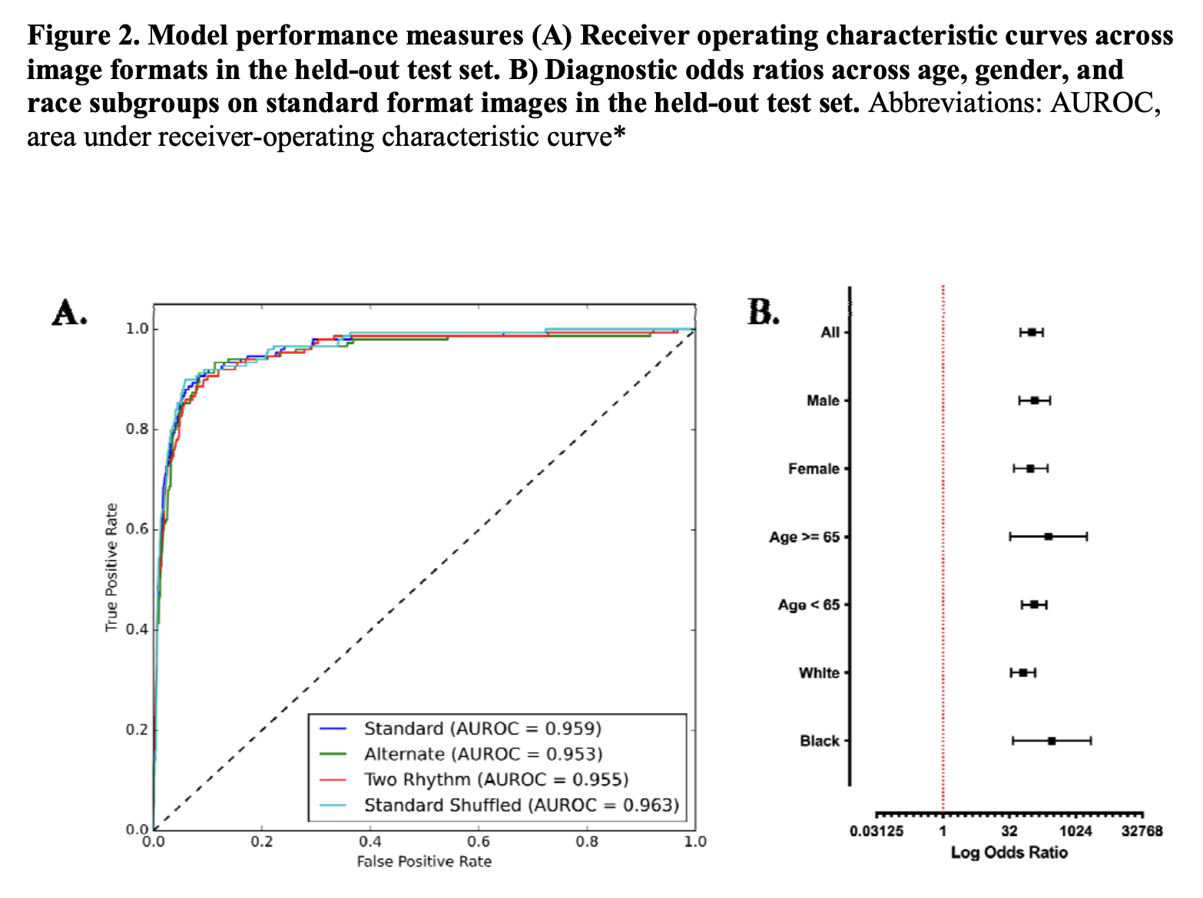
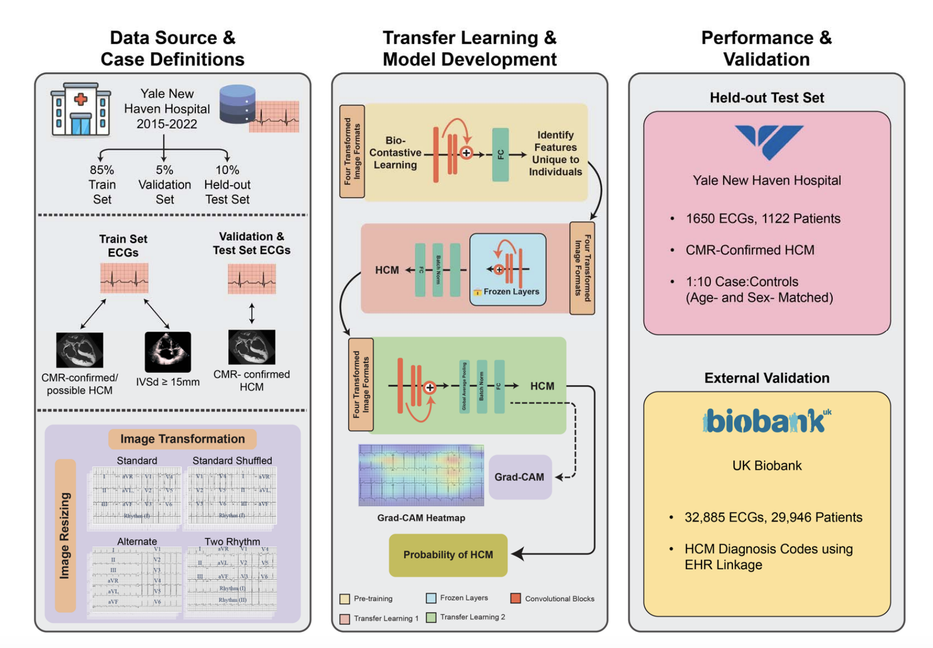

Slide 26
Identification of high-risk imaging features in hypertrophic cardiomyopathy using electrocardiography: A deep-learning approach
Background
Patients with hypertrophic cardiomyopathy (HCM) are at risk of sudden death, and individuals with ≥1 major risk markers are considered for primary prevention implantable cardioverter-defibrillators. Guidelines recommend cardiac magnetic resonance (CMR) imaging to identify high-risk imaging features. However, CMR imaging is resource intensive and is not widely accessible worldwide.
Objective
The purpose of this study was to develop electrocardiogram (ECG) deep-learning (DL) models for the identification of patients with HCM and high-risk imaging features.
Methods
Patients with HCM evaluated at Tufts Medical Center (N = 1930; Boston, MA) were used to develop ECG-DL models for the prediction of high-risk imaging features: systolic dysfunction, massive hypertrophy (≥30 mm), apical aneurysm, and extensive late gadolinium enhancement. ECG-DL models were externally validated in a cohort of patients with HCM from the Amrita Hospital HCM Center (N = 233; Kochi, India).
Results
ECG-DL models reliably identified high-risk features (systolic dysfunction, massive hypertrophy, apical aneurysm, and extensive late gadolinium enhancement) during holdout testing (c-statistic 0.72, 0.83, 0.93, and 0.76) and external validation (c-statistic 0.71, 0.76, 0.91, and 0.68). A hypothetical screening strategy using echocardiography combined with ECG-DL–guided selective CMR use demonstrated a sensitivity of 97% for identifying patients with high-risk features while reducing the number of recommended CMRs by 61%. The negative predictive value with this screening strategy for the absence of high-risk features in patients without ECG-DL recommendation for CMR was 99.5%.
Conclusion
In HCM, novel ECG-DL models reliably identified patients with high-risk imaging features while offering the potential to reduce CMR testing requirements in underresourced areas.
https://www.heartrhythmjournal.com/article/S1547-5271(24)00085-7/abstract

Slide 27
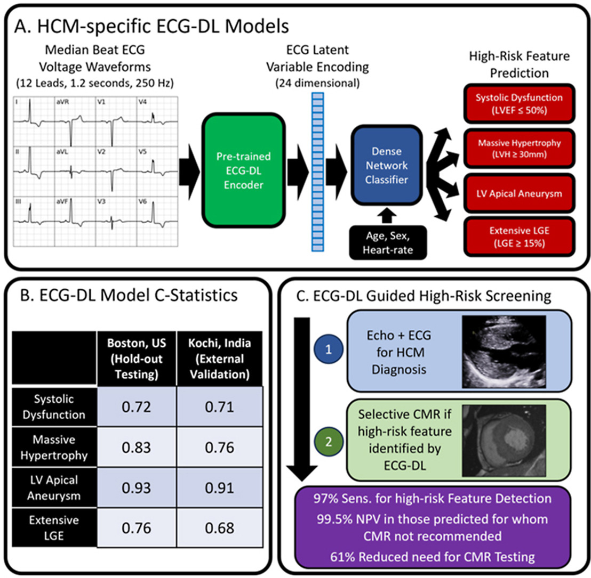

Slide 29
Model for classification of heart failure severity in patients with hypertrophic cardiomyopathy using a deep neural network algorithm with a 12-lead electrocardiogram
https://pubmed.ncbi.nlm.nih.gov/38056911/

